Slide 1
Bully Prevention Program Training

Slide 2
Define Bullying
What is Bullying?
Bullying must have the 3 p’s:
Power – imbalance of power
Purpose – person intends to hurt you
Pattern or Persistence – person continues action over and over again

Slide 3
Bully Blockers Video

Slide 4
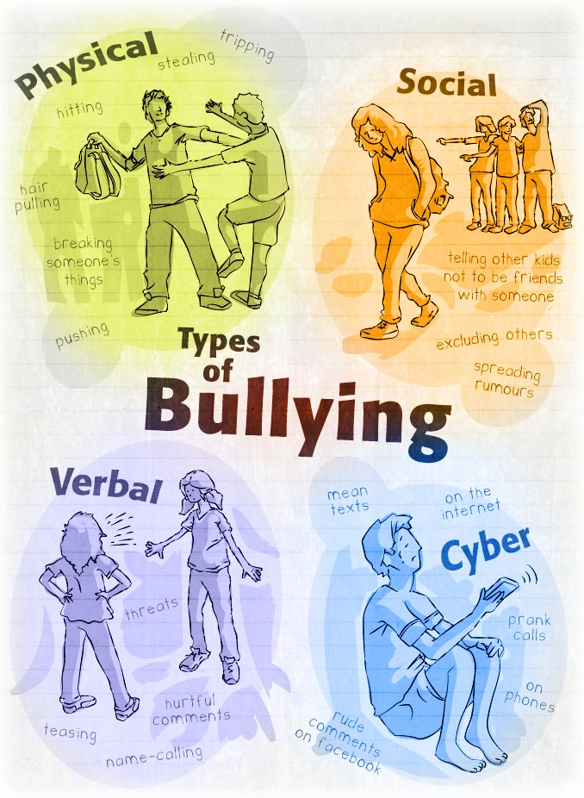
Define Bullying
What sort of bullying do you see in schools?
Notes:
Bullying has become such a popular term that students and adults can often mistake misconduct, accidents, for bullying.

Slide 5
Define bullying
Quiz
1) A student trips another student in the lunchroom on purpose
2) A group of female students seem to always exclude an individual girl during recess
3) When Bubba gets upset he starts calling the other students names
4) Students in the classroom laugh when others make mistakes

Slide 6
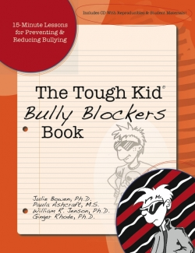
Bully Blockers book overview
Take 3 minutes and begin to familiarize yourself with the new book

Slide 7
Activity Time
0
0
5
4
3
2
1
0
0
9
8
7
6
5
4
3
2
1
0
9
8
7
6
5
4
3
2
1
0
9
8
7
6
5
4
3
2
1
0
9
8
7
6
5
4
3
2
1
0
9
8
7
6
5
4
3
2
1
0
9
8
7
6
5
4
3
2
1
0
0
3
0
2
Hours
Minutes
Seconds

Slide 8
Activity Time
0
0
5
4
3
2
1
0
0
9
8
7
6
5
4
3
2
1
0
9
8
7
6
5
4
3
2
1
0
9
8
7
6
5
4
3
2
1
0
9
8
7
6
5
4
3
2
1
0
9
8
7
6
5
4
3
2
1
0
9
8
7
6
5
4
3
2
1
0
0
2
0
1
Hours
Minutes
Seconds

Slide 9
Activity Time
0
0
5
4
3
2
1
0
0
9
8
7
6
5
4
3
2
1
0
9
8
7
6
5
4
3
2
1
0
9
8
7
6
5
4
3
2
1
0
9
8
7
6
5
4
3
2
1
0
9
8
7
6
5
4
3
2
1
0
9
8
7
6
5
4
3
2
1
0
0
1
0
0
Hours
Minutes
Seconds

Slide 11
Bully Blockers book overview
What did you notice about the book?
Book Highlights
Table of Contents
Sections and Skills
Proactive Approach (p.13)
Bullies and potential victims
Year-long Planning
Scope and Sequence (handout)

Slide 12
Bully Blockers book overview
Bully Blocker Lessons
Book Highlights
Grouped into six skills
Learning about bullying
Bully Blocker Tools
Friendship Builders
Problem Solvers
Respecting Differences
Confidence Boosters
15-minute lessons suitable for classroom intervention
Reproducible activities on included CD

Slide 13
Bully Blockers book overview
Bully Blocker Lessons
General Lesson Outline
Lesson Objective
Teach the skills
Practice the skill
Check for understanding
Follow-up

Slide 14
Bully Blockers book overview
Lesson Planning
Lesson 7: Bystander Blockers (p. 152)
Bystanders can block bullying
Don’t join in; don’t laugh at the bullying
In a calm voice, tell the bully to stop
Help student who is being bullied walk away
Get help from an adult
Don’t fight the bully
Be a friend

Slide 15
Practice makes perfect

Slide 16
Practice makes perfect
The Lesson Plan
A put down can be:
Name-calling
Laughing at someone’s mistake
Making fun of other’s abilities
If you have ever been put down, how did you feel?
Why do you think people put others down?
Explain Put-up
Saying something that makes people feel good
2:1 Ratio

Slide 17
Pick a Lesson
Lesson Plan
What you can do if you are bullied and when to report bullying (p. 134)

Slide 18
Connect lessons to literature

Slide 19
Practice Makes perfect
Students are making fun of a new student that doesn’t speak English
Student’s are referring to EVERYTHING as “Bullying”
A group of students appear to be creating a lot conflict for others in the class

Slide 20
Questions?
G. Norma Villar – Consultant
801-567-8187
Jeani Mulliner - Teacher Specialist 801-567-8283

